Slide 1
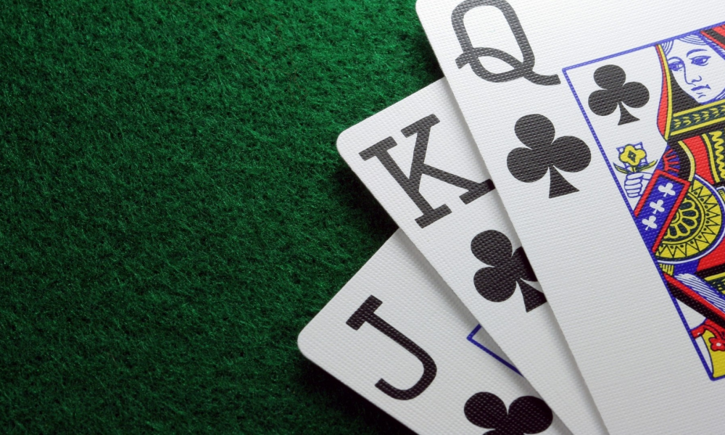
PokerGame
Team 3
So Mi Choi, Bo Heon Jeong, Hanchen Li,
Sang Rhee, Yixin Wang, Yuying Wang
https://github.com/srhee91/PokerGame

Slide 2
Problem motivation
People need to have fun gambling without losing actual money online. An interactive Texas Hold’em
game can be created to satisfy this need.

Slide 3
Project goal
Our project will create an interactive poker game written in Java that can support up to 8 players by the end of the semester.

Slide 4
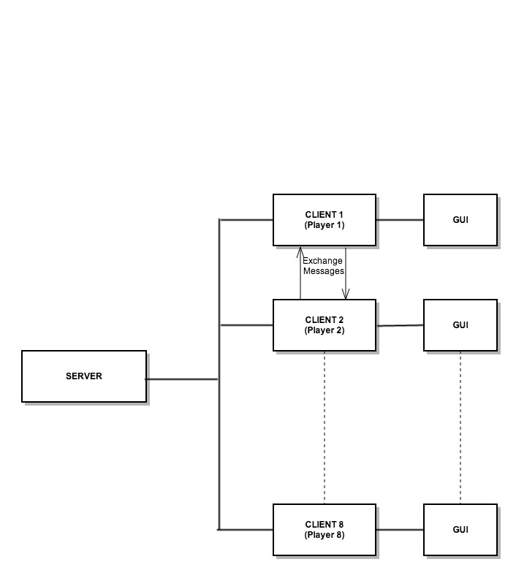
Client-Server Model

Slide 5
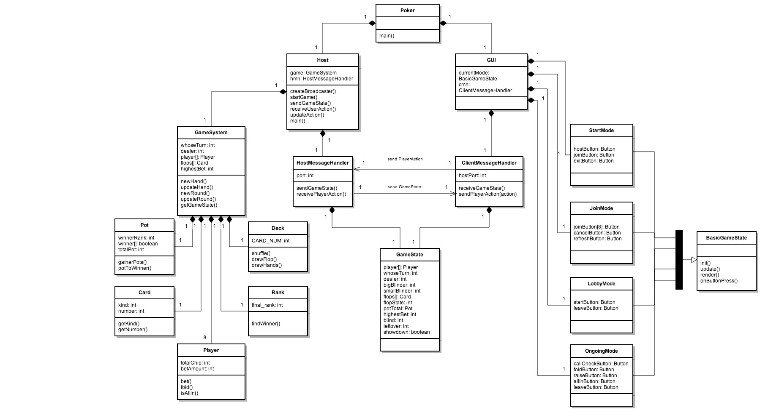

Slide 6
DEMO

Slide 8
Sprint 3 – Description of tasks (1/4)
1. Integrate the animations to correctly respond to received GameState from the host to show each player’s actions. (User Story 1)

Slide 9
Sprint 3 – Description of tasks (2/4)
6. Debug the Rank class through adding test cases that handle all possibilities of poker-hands in the TestRank class. (User Story 4)

Slide 10
Sprint 3 – Description of tasks (3/4)
7. Debug the GUI portion of the game by play-testing the game with all possible user inputs. (User Story 4)

Slide 11
Sprint 3 – Description of tasks (4/4)
6. Debug the GameSystem portion of the game by play-testing the game with all possible user inputs. (User Story 4)

Slide 12
Thank you!

